Slide 1
Building homes in challenging environments
Lesson 9
How house design is adapted to enable development in extreme environments.

Slide 2
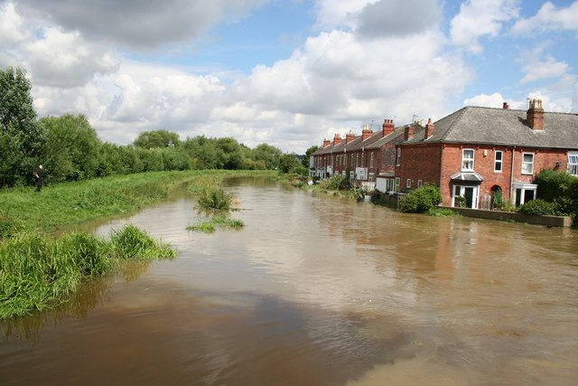
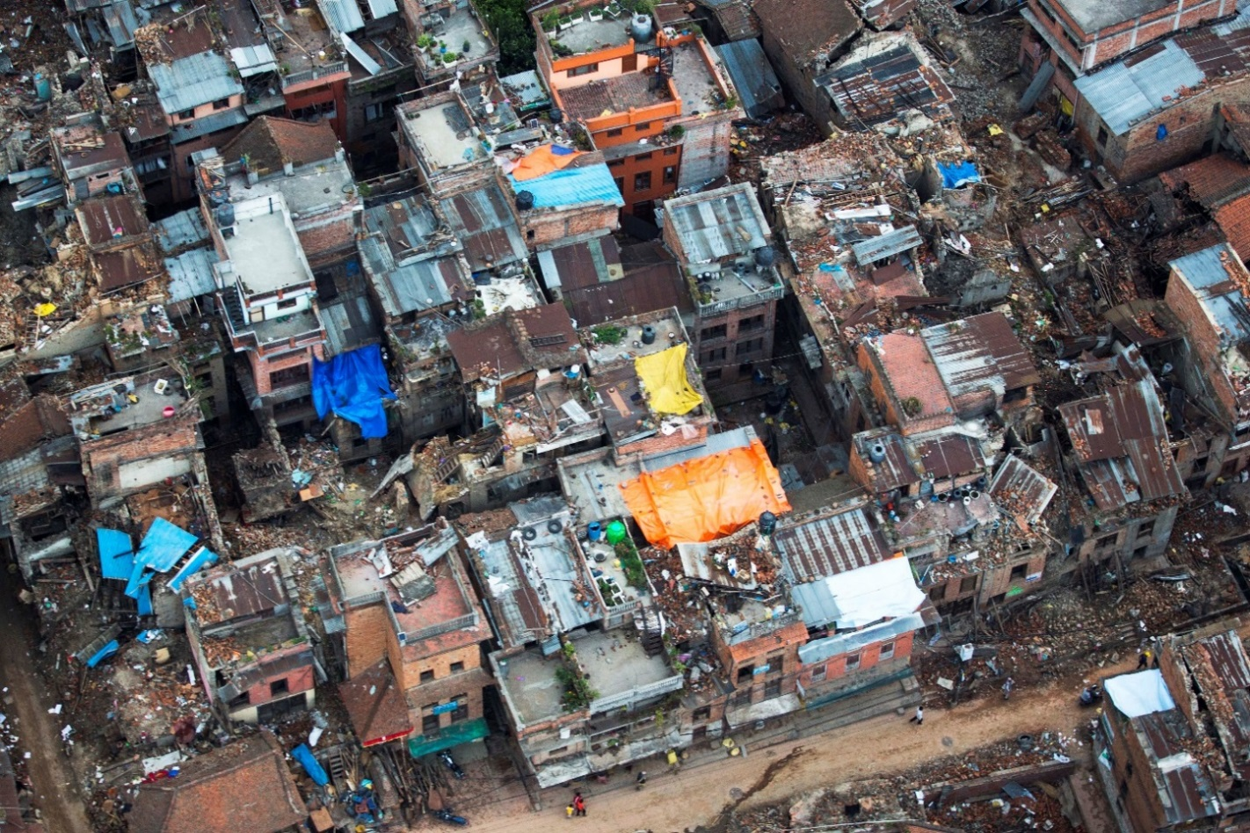
Building homes in extreme areas…
What links these two images?
UK
Nepal
Notes:
Flood image: http://commons.wikimedia.org/wiki/File:River_Witham_in_flood_-_geograph.org.uk_-_502375.jpg?uselang=en-gb
Nepal Earthquake image: "Hires 150508-M-WN441-131A An aerial image of damages after earthquake in Nepal" by U.S. Marine Corps photo by Staff Sgt. Jeffrey D. Anderson - http://www.defense.gov/home/features/2015/0415_nepal-earthquake/, http://www.defense.gov/dodcmsshare/photoessay/2015-05/hires_150508-M-WN441-131A.jpg. Licenced under Public Domain via Wikimedia Commons - http://commons.wikimedia.org/wiki/File:Hires_150508-M-WN441-131A_An_aerial_image_of_damages_after_earthquake_in_Nepal.jpg#/media/File:Hires_150508-M-WN441-131A_An_aerial_image_of_damages_after_earthquake_in_Nepal.jpg

Slide 3
Questions…
Thinking about the previous images, discuss the following questions.
Which of the previous two places do you think would be worse to live in?
Explain your reasons why you think this.
Living in the UK, what natural disasters to house builders have to think about when planning developments and designing homes?
Can you think of any recent examples?
Outside of the UK, what sort of natural disasters do house builders need to think about when planning developments and designing homes?
Which countries in particular? Can you think of any recent examples?

Slide 4
Ways to mitigate against flooding…
Raising the ground level of homes.
Flood walls and fencing can be designed.
‘Bunds’ can be build around groups of houses or individual properties. A bund is a retaining wall or earth embankment that holds flood water at bay.
Not building in flood risk areas.
Flood defences, such as dams, could be built upstream.
Landscaping can be used to create natural flood areas and to divert flood water
Land use zoning can be used to put homes outside of flood risk areas.

Slide 5
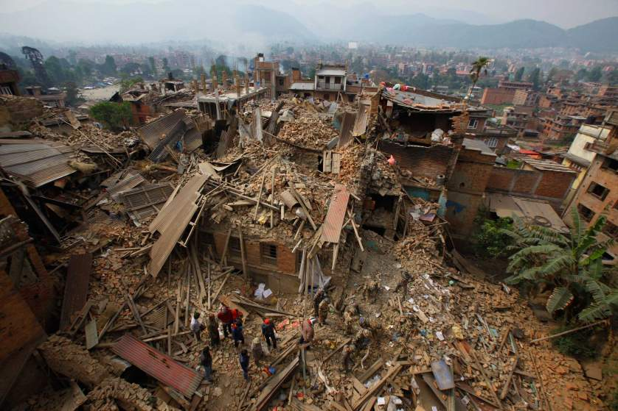
Nepal earthquake, April 2015
The April 2015 earthquake in Nepal demonstrated what happens when homes are not designed to withstand the impact of a natural disaster; in this instance an earthquake.
Using the fact sheet in front of you as a guide, create a similar document describing the situation in Nepal.
How would you create homes that could survive an earthquake?
Notes:
Image courtesy of: https://timedotcom.files.wordpress.com/2015/04/nepal-earthquake-aftermath-15.jpg?quality=65&strip=color&w=838

